Slide 1
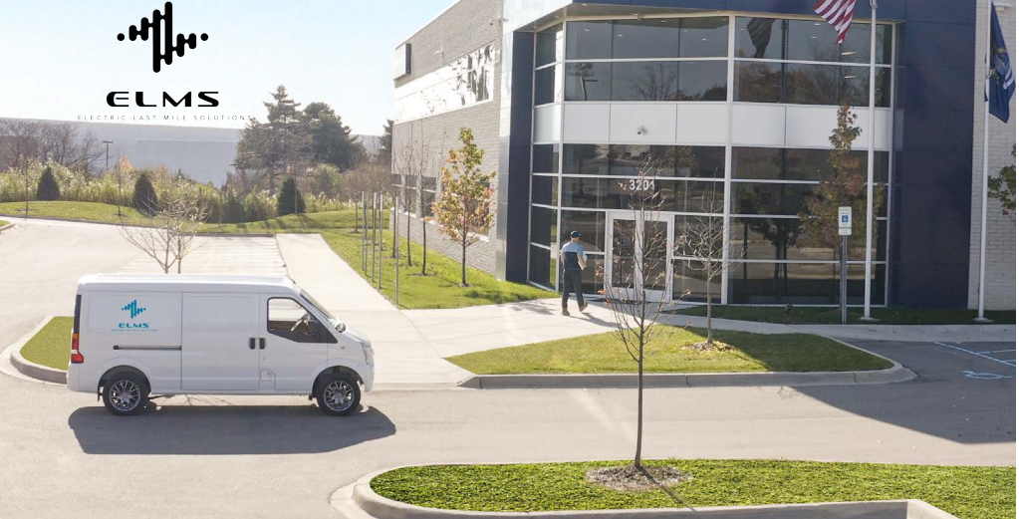
Role Specification
Chief Exec Officer,
Electric Last Mile Solutions
Contact
Scott Texeira (Palo Alto)
Scott.Texeira@egonzehnder.com
t. +1 650 847 3075
m. +1 650 387 6922
Naveed Bandukwala (Chicago)
Naveed.Bandukwala@egonzehnder.com
t. +1 312 260 8815
m. +1 312 286 6652
Notes:
How can we make sure that the aligment of contact details remains correct?

Slide 2
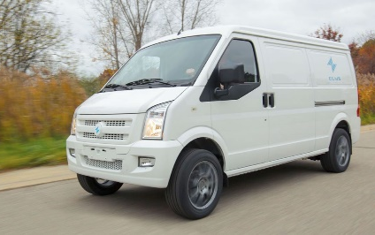
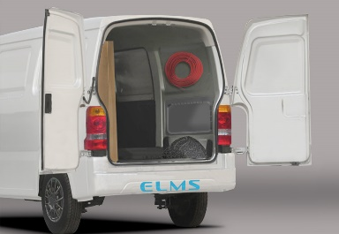
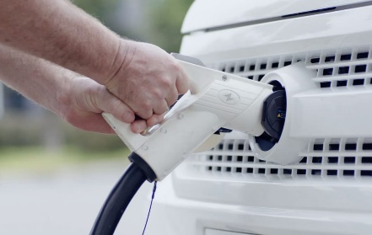
About ELMS
Electric Last Mile Solutions (“ELMS”) is a new electric vehicle company transforming commercial delivery networks for the e-mobility businesses of today and tomorrow. ELMS technology is designed to deliver the most reliable and most efficient Electric Last Mile Solutions combining integrated deep data analytics, customization and sustainable engineering.
Headquartered in Auburn Hills, Michigan, ELMS plans to produce its Urban Delivery van in Indiana at an EV production-ready manufacturing plant. The delivery vehicle will feature a range of 150 miles, with the capability of being fully charged in as little as two hours. ELMS vehicles will also feature advanced onboard and over-the-air data and telematics that allow fleet managers to engage in business planning and fleet tracking for optimal efficiency. The connectivity technology built into the delivery vehicle will also help provide technology-based service updates for its vehicles via over-the-air capabilities.
The ELMS management team combines executive experience from GM, Workhorse, FCA, BMW, Key Safety Systems, and other leading OEMs and tier 1 manufacturers to focus on delivering on the company’s execution and growth strategy. To date, ELMS has over 45,000 pre-orders from customers including leading brands and some of the largest fleet managers and dealers in the country.
ELMS is collaborating with Geotab as part of its product rollout, and its line of products will be available on Geotab’s Electric Vehicle Suitability Assessment (EVSA) tool. The EVSA solution is designed to help enable fleets to go electric by analyzing a fleet’s existing telematics data and creating an electrification recommendation based on each vehicle’s distinctive driving patterns.
In December 2020, ELMS and Forum Merger III Corporation (Nasdaq: FIII), a special purpose acquisition company, announced that they have entered into a definitive agreement for a business combination that will result in ELMS becoming a publicly listed company. Upon closing of the transaction, which is expected to occur in the first quarter of 2021, the combined company will be named Electric Last Mile Solutions, Inc. and will be continue to be listed on the Nasdaq Capital Market under the new ticker symbol “ELMS”. The transaction reflects a pro forma implied equity value for the combined company of approximately $1.4 billion.
Following the combination, ELMS expects to launch its Urban Delivery van as the first electric Class 1 commercial vehicle in the U.S. market in the third quarter of 2021.
More information about ELMS may be found at www.electriclastmile.com

Slide 3

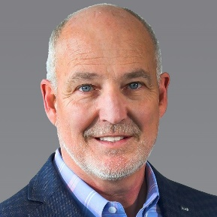








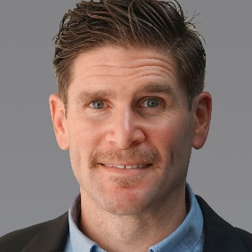












World-Class Proven Leadership Team
Jason Luo
Executive Chairman, Founder
James Taylor
CEO, Founder
Jerry Hu
COO
Justin Prann
CCO
Kev Adjemian
CTO
Albert Li
CFO
Benjamin Wu
GC

Slide 4
















Seasoned Board of Directors
Richard Peretz
Former CFO, UPS
Shauna McIntyre
CEO, Sense Photonics
Brian Krzanich
CEO, CDK Global
Neil Goldberg
Chairman & CEO, Raymour & Flannigan
Jason Luo
Executive Chairman, Founder, ELMS
James Taylor
CEO, Founder, ELMS
David Boris
Co-CEO and CEO, Forum Merger III Corp

Slide 5

The Role
Job Purpose
While ELMS builds momentum towards the delivery of its first production vehicle, the company foresees additional long-term value and differentiation through software and data solutions. To realize the potential of its software and data solutions, ELMS seeks a senior leader for the role of Chief Digital Officer to oversee all efforts related to these functional areas. He or she will serve as the business unit leader and effective general manager of all software and data solutions, ranging from fleet management to driver safety, compliance, diagnostic and optimization data, location-based services, and more. Key responsibilities for this role include:
Manage the conception, development, and production of ELMS software and data solutions
Oversee key partnerships with third-party software providers (e.g. Geotab)
Serve as the P&L owner and business unit leader for software and data-related businesses, including new solutions such as SaaS / subscription models
Build a lead high-performance team in software development, product management, IT systems, go-to-market, and more as needed.
Location
The company is open to a number of appropriate locations for this role, with travel as required for the success of the role.
Reports to
James Taylor, Founder & Chief Executive Officer
James is a highly accomplished automotive executive that has led many ICE and hybrid vehicle and brand launches in his 30-year career. He is now applying his extensive experience to define and disrupt the commercial last mile vehicle sector.
Former CEO of Workhorse and CMO at Karma Automotive. Served several high-profile leadership positions at General Motors including President of Cadillac and CEO of Hummer.

Slide 6
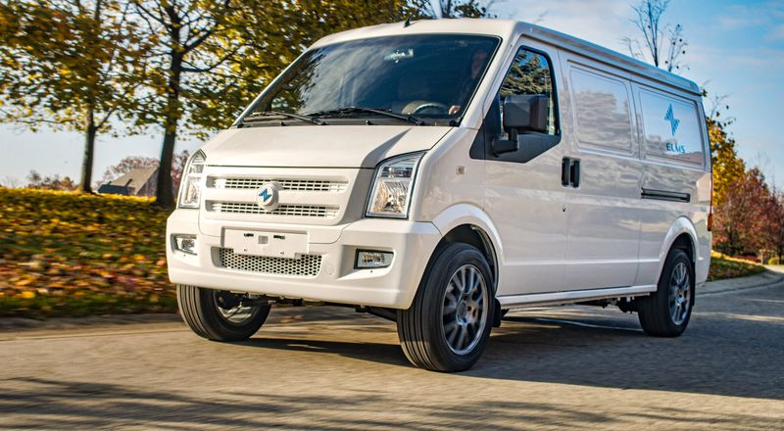
Candidate Profile
The ideal candidate will be a senior general manager and transformational leader who is able to build a cohesive team, develop and communicate a compelling vision across various functions within the organization, and energize the team behind this vision. This person should have deep software leadership experience, with significant expertise in successfully developing and commercializing new products and managing a portfolio of multiple products at various stages. The ideal candidate will bring knowledge of the automotive ecosystem and can serve as the evangelist for the company‘s technology and solutions. Culturally, this individual will possess a competitive, entrepreneurial spirit and a positive bias towards action that fits with the fast-paced culture of ELMS.
As a leader, s/he will be mature, smart, data-oriented, driven, and forward thinking, while approachable and a good developer and manager of talent.

Slide 7
Leadership Competencies
Change Leadership
A visionary with a proven record of executing on the vision
A natural “dirt under the fingernails” approach – gets enjoyment from the interactions created by wandering around. Must be willing and able to engage the detail of the job as needed – should not be a classic delegator. A strong manager based on establishing clear expectations, creating a supportive environment, and effective feedback.
Willing to step out into traffic and act as an advocate. Must be able to build a case, present, and “carry the day” with a sound and coherent analytical argument. At the same time must be a practitioner of the art of intelligent compromise. Must be committed to impact outcomes through influence, not hierarchy.
Collaboration and Influencing
Effective advocacy – whether that is with the CEO or a junior software developer. The ability to make a well reasoned case for doing something different than what the other person may initially desire.
An approachable, hands on, team player problem solver with the accompanying skill set and commitment to be a strong mentor both inside and outside the department. A direct communicator.
A shared belief and commitment to making organizational decentralization and delegation work; willing to let others shine. Must have a nuanced understanding of the interplay between staff and operations.
Multi-modal - able to adopt style to a range of circumstances; must be a committed internationalist
Strategic Orientation
Strong intelligence coupled with insight, active curiosity, high energy and non-linear imagination. Must be able to derive concepts from “first principles” and flourish in an adaptive, intellectually aggressive, innovative management environment. Must be able to integrate different elements into a holistic picture.
A detailed, analytically driven and rigorous decision maker but still capable of living with “fuzzy border” ambiguity (consistent with an international technology company with an applications focus).
Results Orientation
Driven to meet performance goals
A commitment to an aggressive lean organization philosophy
Strong work ethic

Slide 8
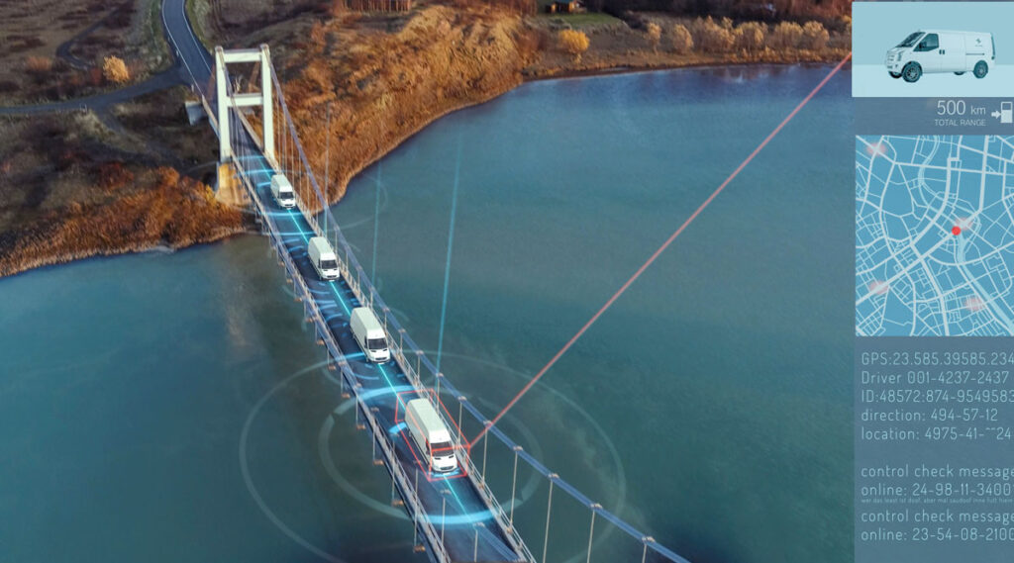
Recent Press
Electric Last Mile Claims 45,000 Van Orders Amid E-Commerce Boom
Electric Last Mile Provides Update on Pre-Orders and Start of Production
Electric Last Mile And Geotab Inc. Announce Partnership
Electric Last Mile: The Electric Vehicle SPAC That Hype Forgot

